Slide 1
Chapter 1: Introduction

Slide 2
Learning outcomes
define and describe the main functions of a GIS and discuss example applications of the technology;
summarize the key features of the general computing technologies that underpin any GIS;
explain the particular importance of the database, which lies at the heart of every GIS; and
reflect on what makes GIS special, and more generally on why “spatial is special”

Slide 3
Section 1.1
What is a GIS?

Slide 4
What is a GIS?
An information system is an association of people, machines, data, and procedures working together to collect, manage, analyze, and distribute information of importance to individuals or organizations.
A GIS is a special type of information system concerned with geographically referenced data.

Slide 5
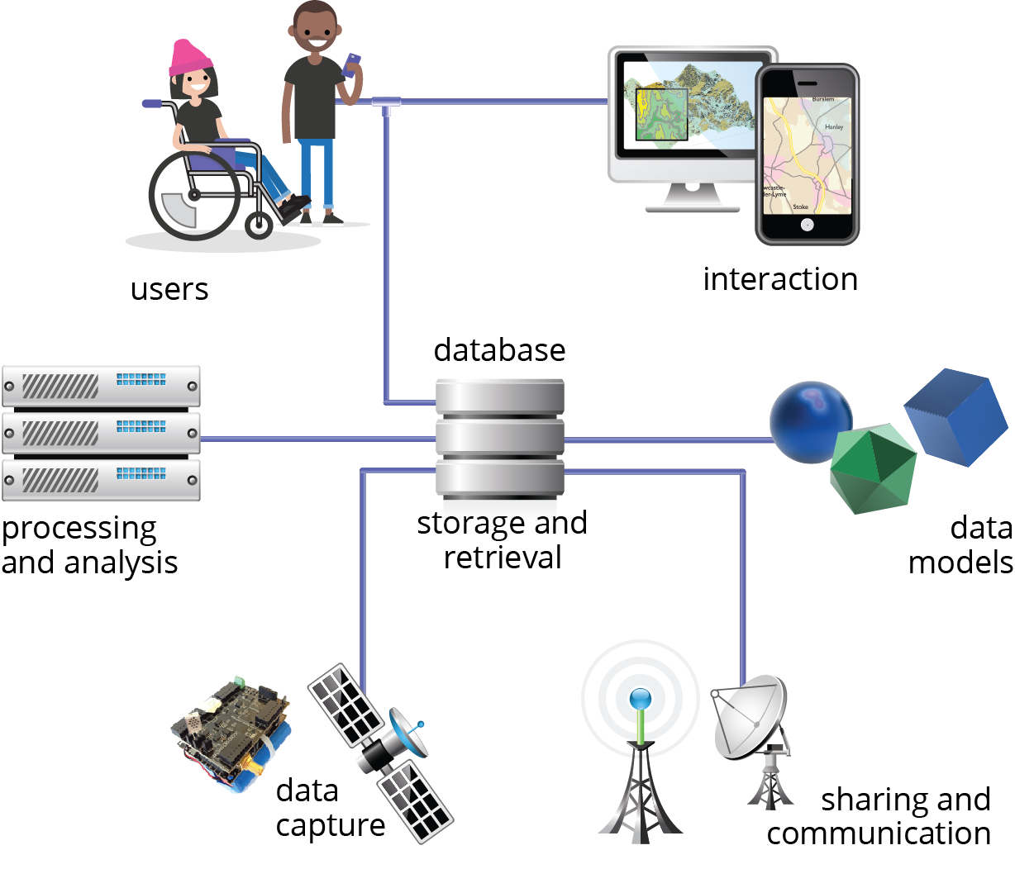
The “shape” of GIS
Data storage and retrieval functions
Data analysis and processing functions
Data capture functions
Data sharing functions
Modeling, interaction, and user functions

Slide 6
Section 1.2
GIS applications

Slide 7
GIS applications
Example application types include:
Resources inventory
Network analysis
Distributed data
Terrain analysis
Layer-based analysis
Location analysis
Spatiotemporal information
Digital twins

Slide 8
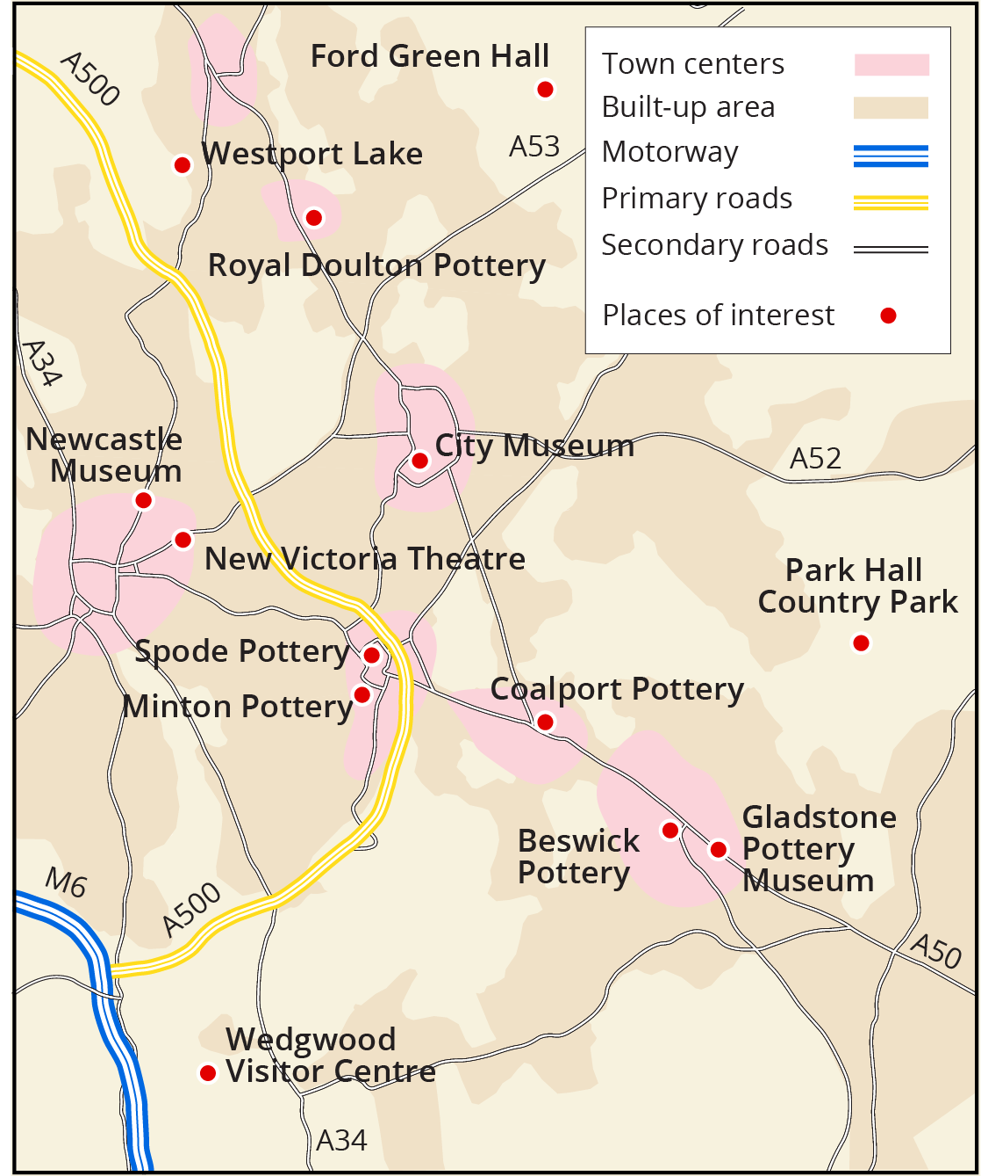
Resources inventory
A tourist information system with significant places of interest

Slide 9
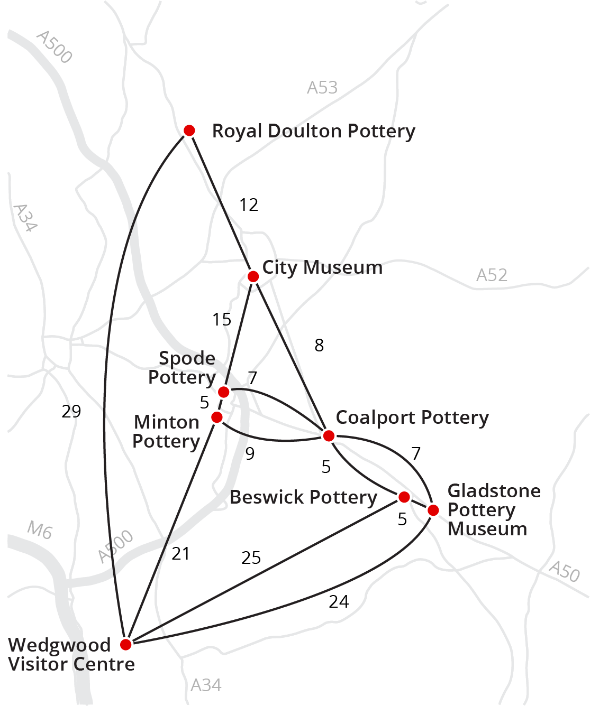
Network analysis
Planning an efficient tour of The Potteries region

Slide 10
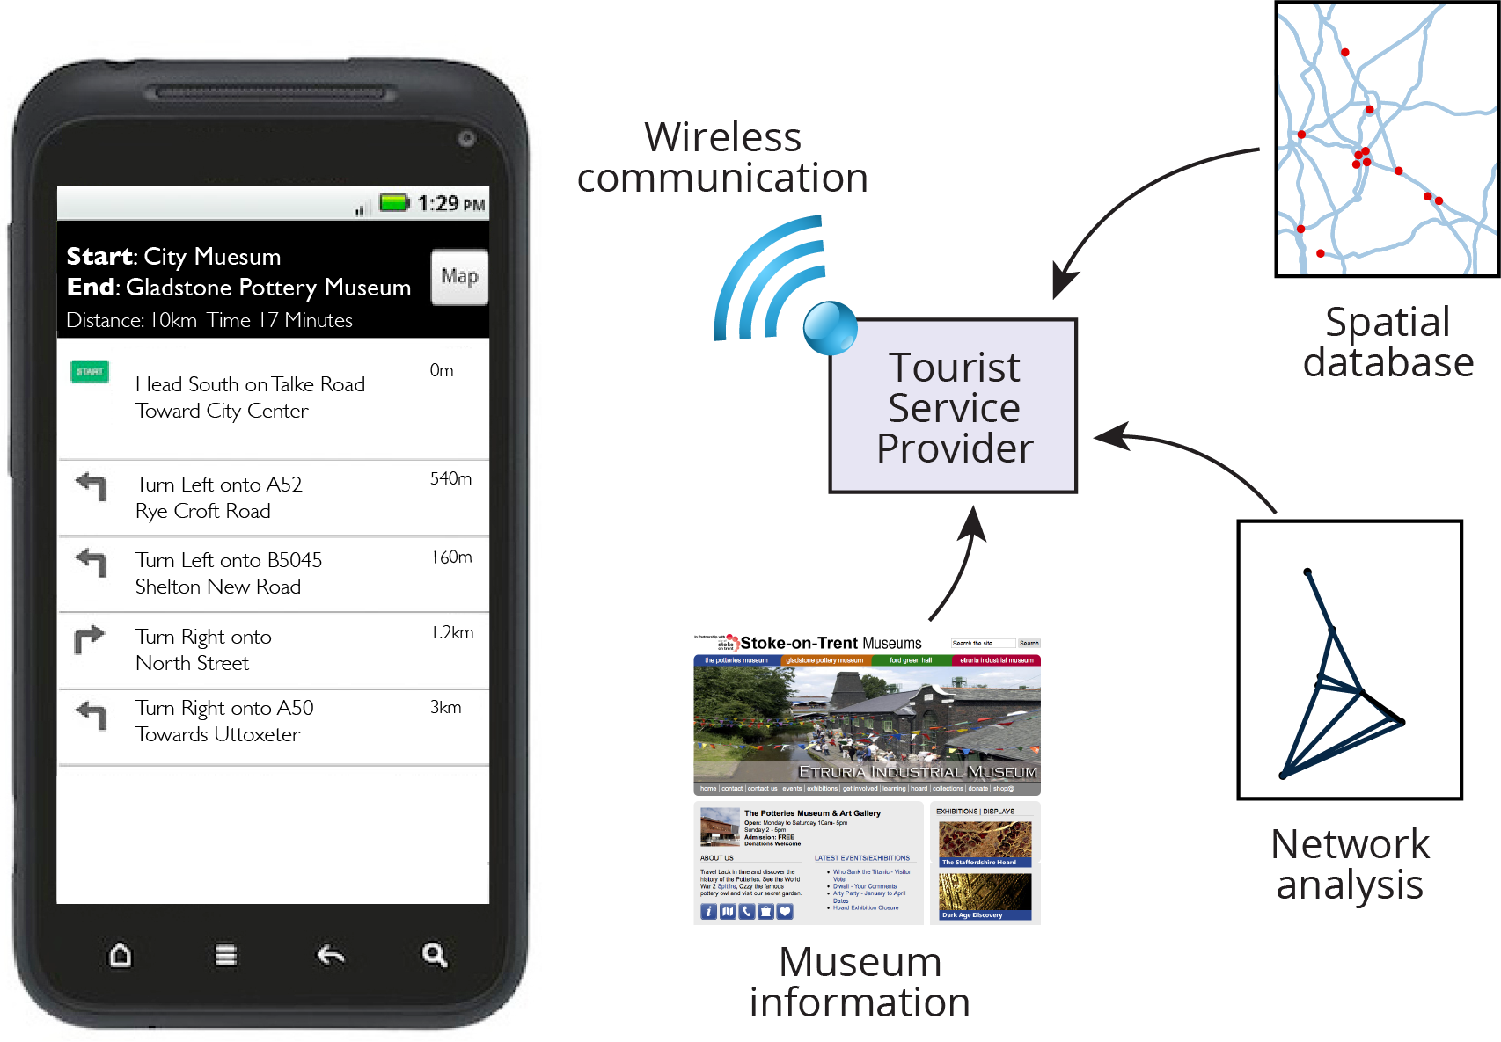
Distributed data
A distributed tourist information system capable of combining multiple information sources in a smartphone app

Slide 11
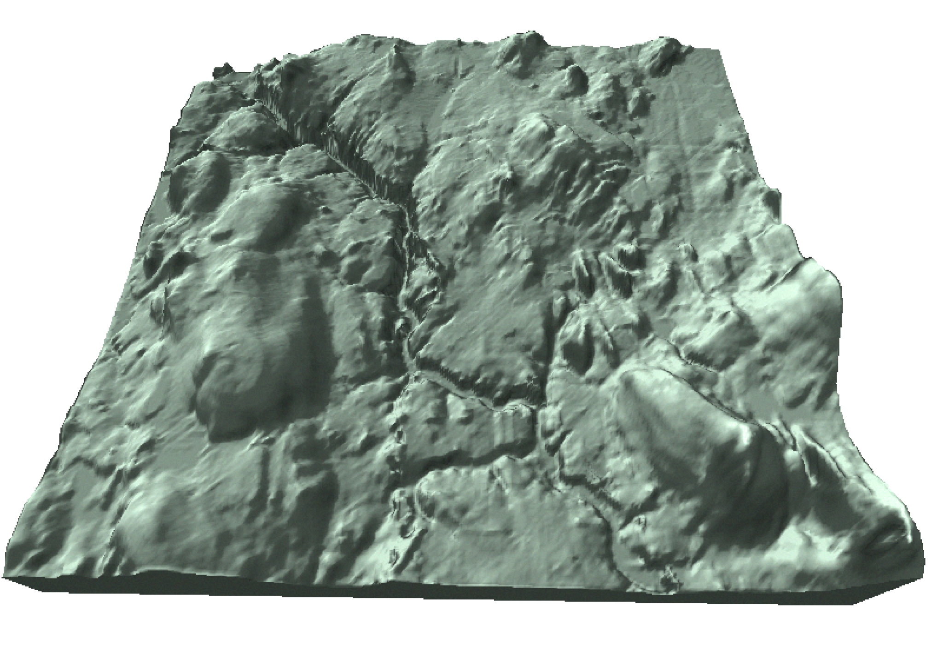
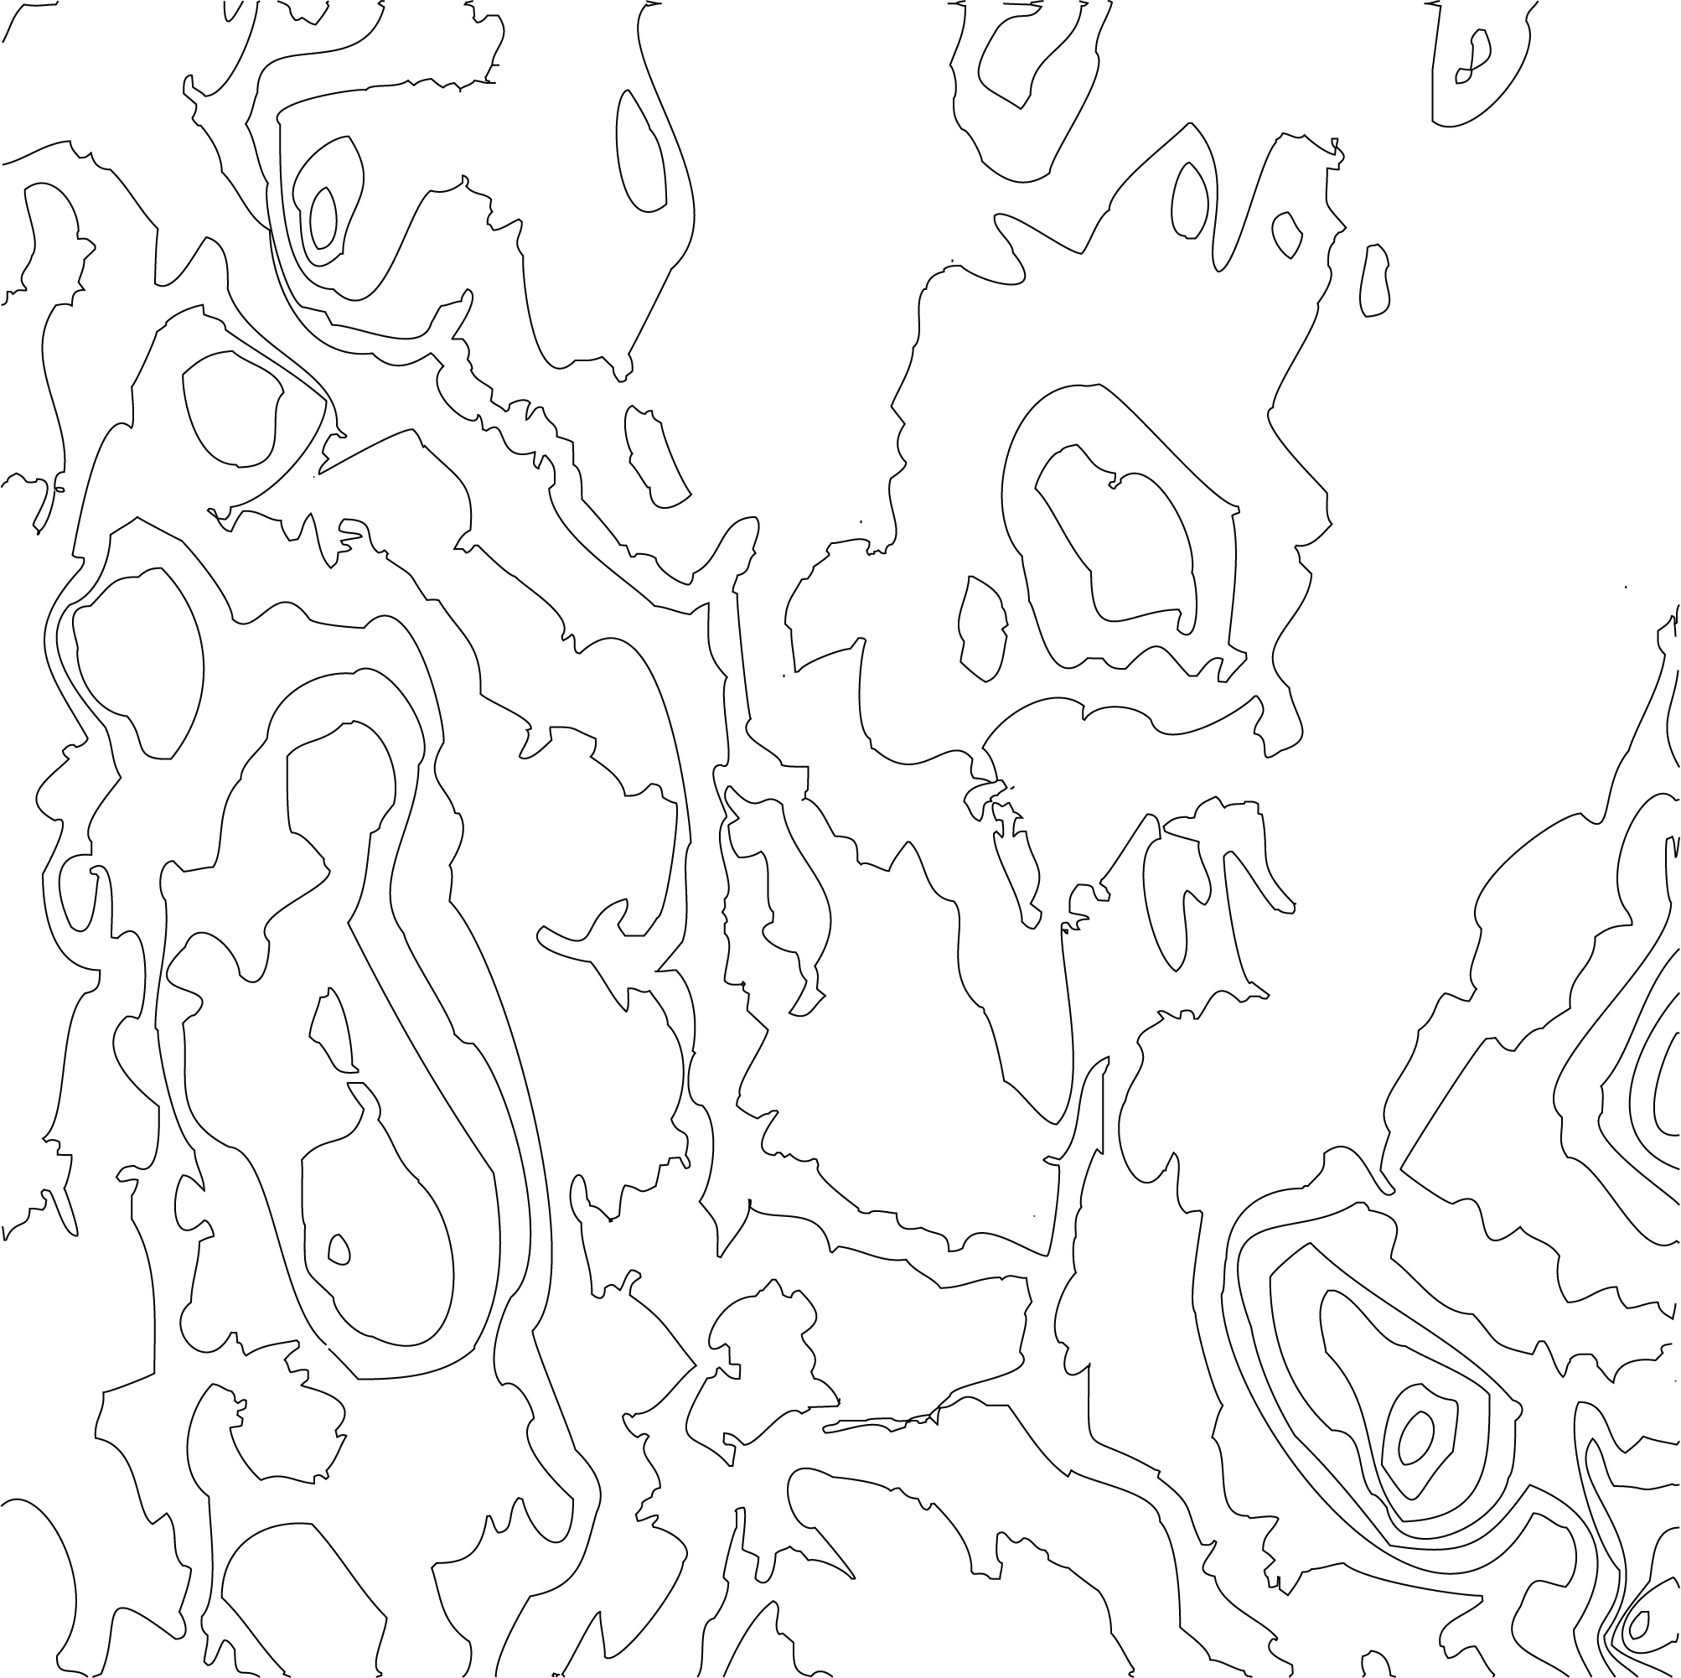
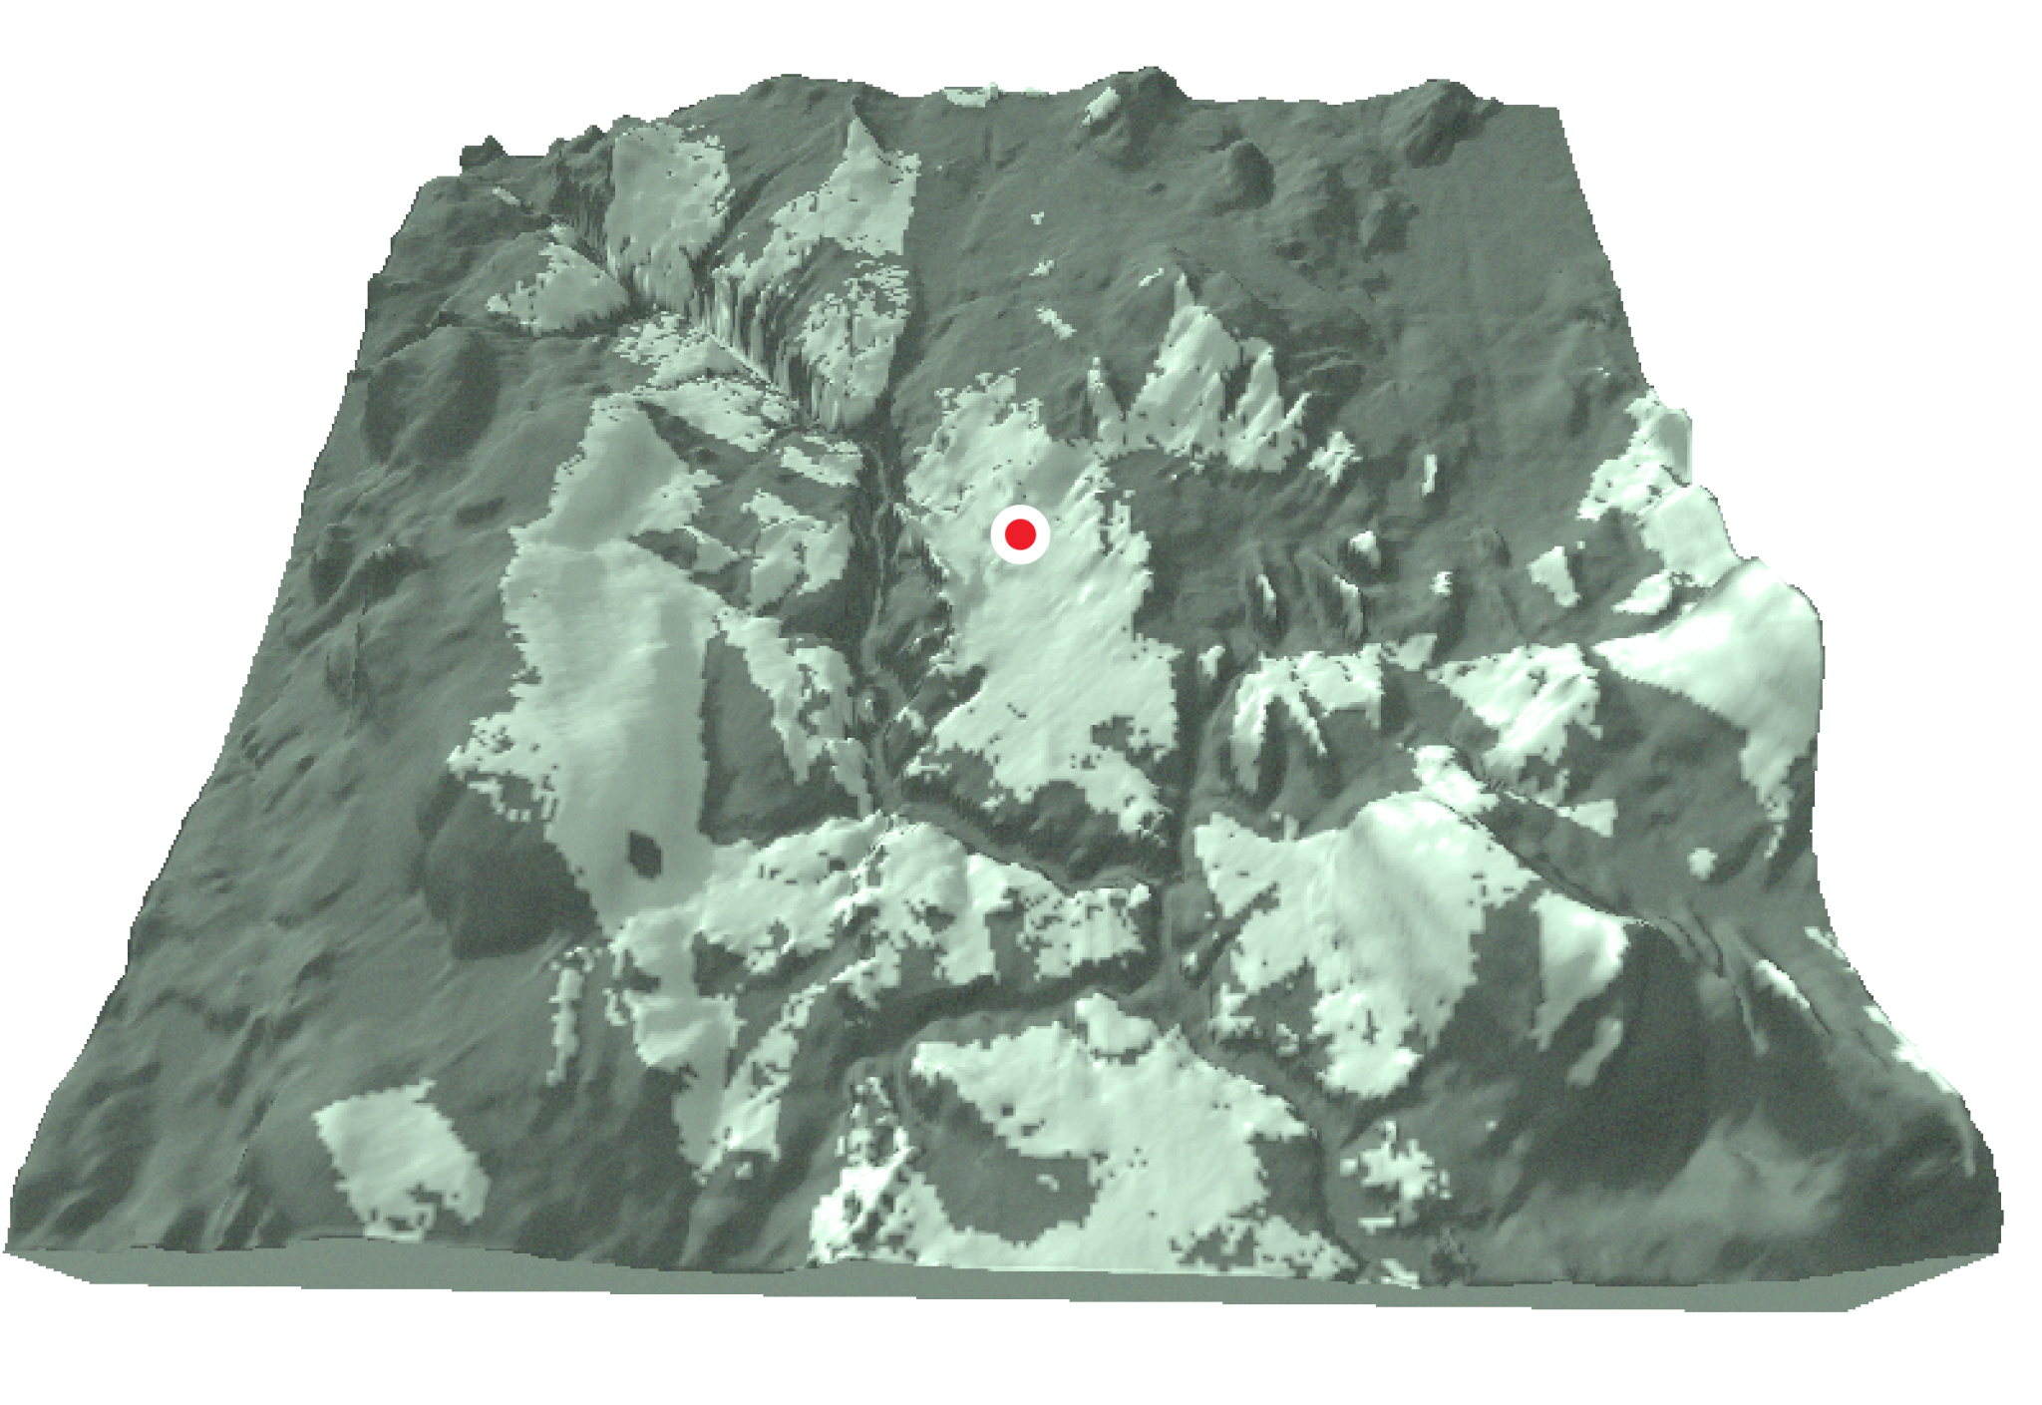
Terrain analysis
Siting an opencast mine to minimize visual pollution

Slide 12
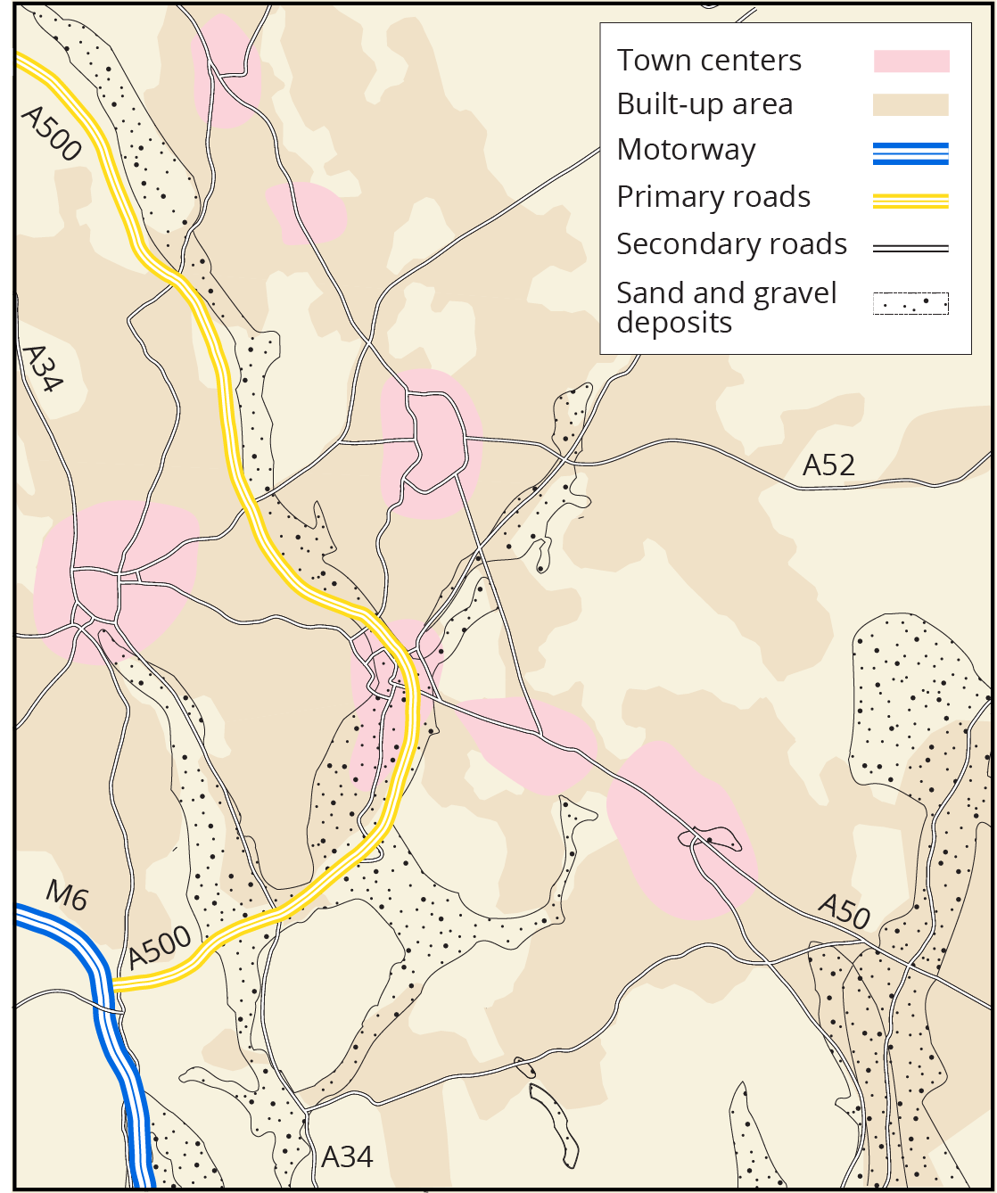
Layer-based analysis
Identifying sites for extraction of mineral ore deposits

Slide 13
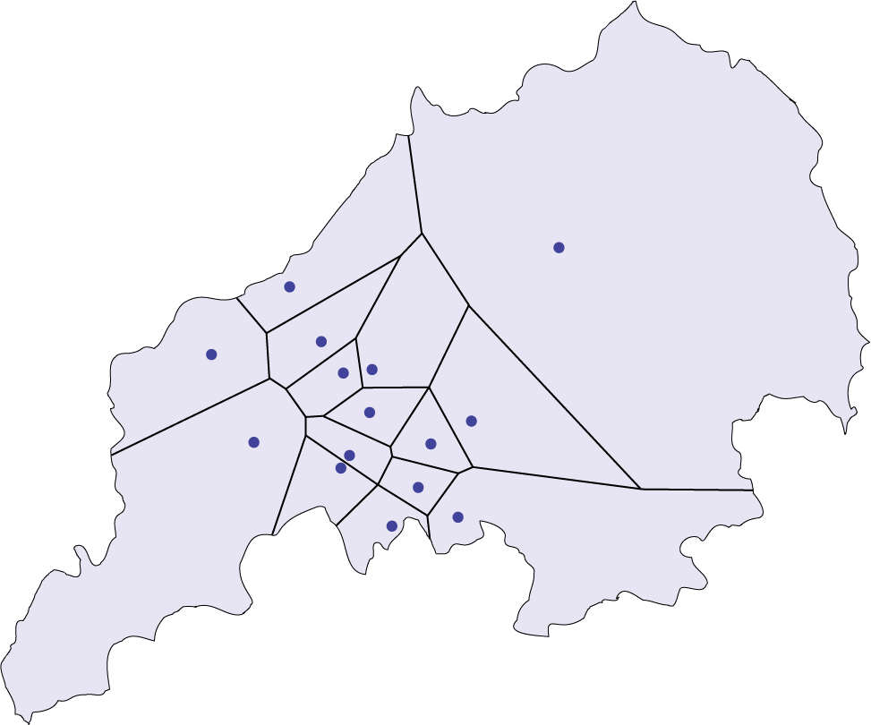
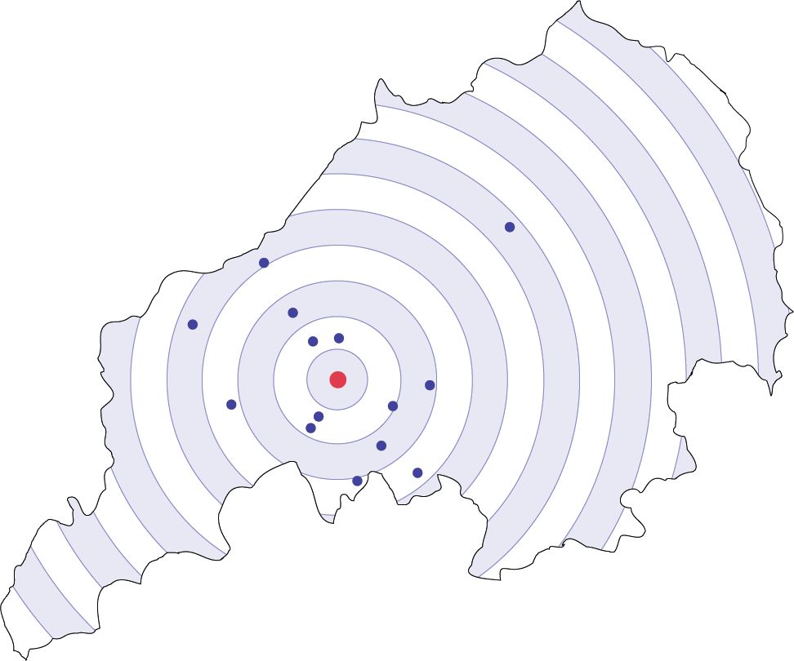
Location analysis
Locating a new clinic in an accessible location in The Potteries

Slide 14
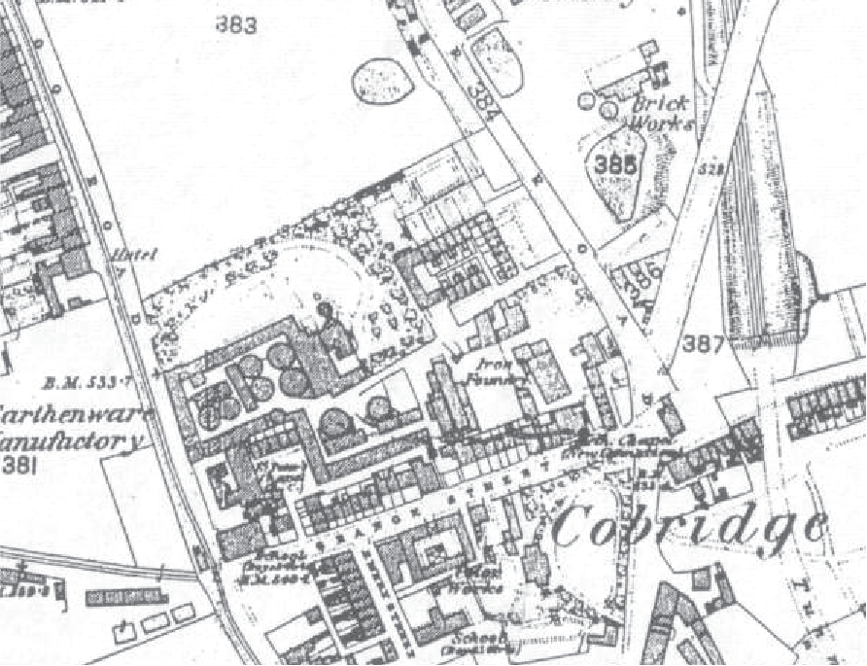
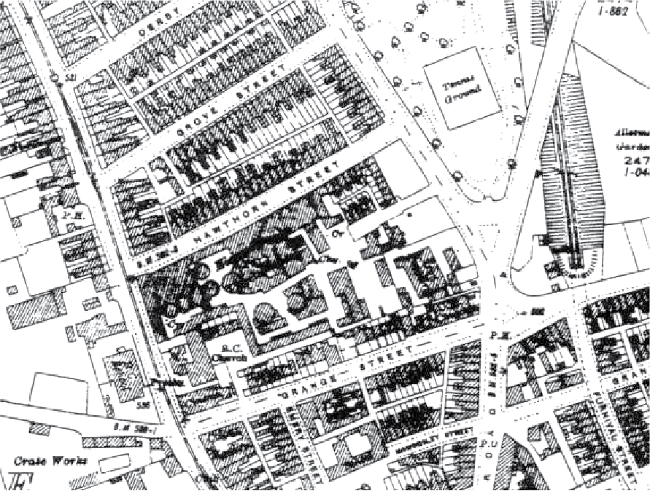
Spatiotemporal analysis
Image source: Ordnance Survey
Tracking changes over time in land and land usage
1878
1924

Slide 15
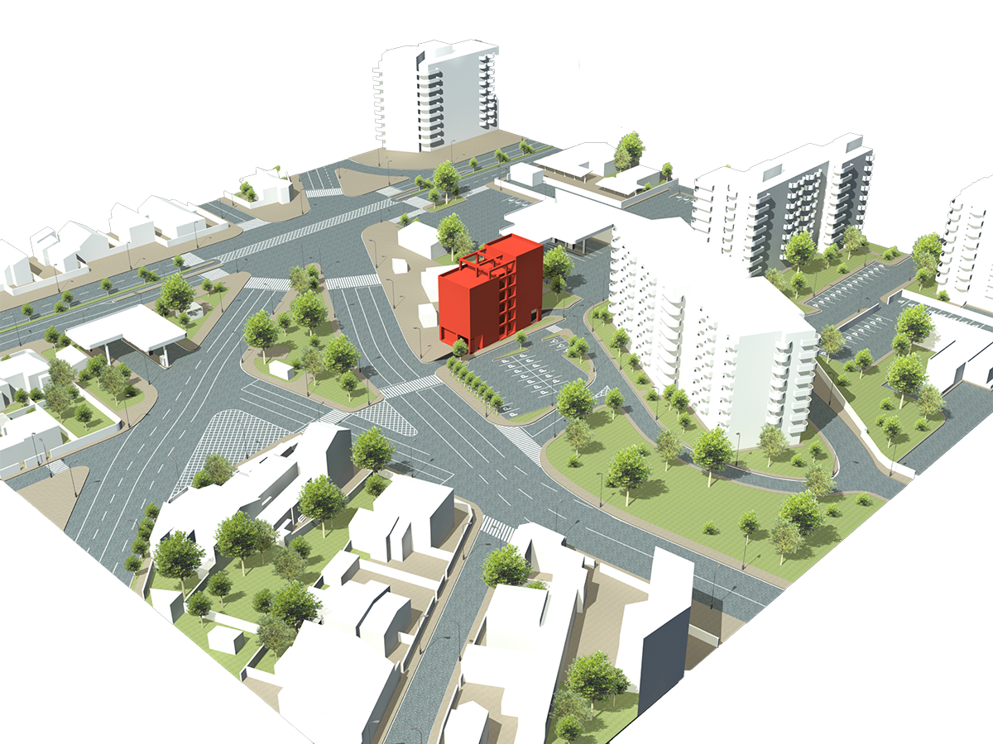
Digital twins
Digital representations of the physical world for smart cities

Slide 16
Section 1.3
GIS models and data

Slide 17
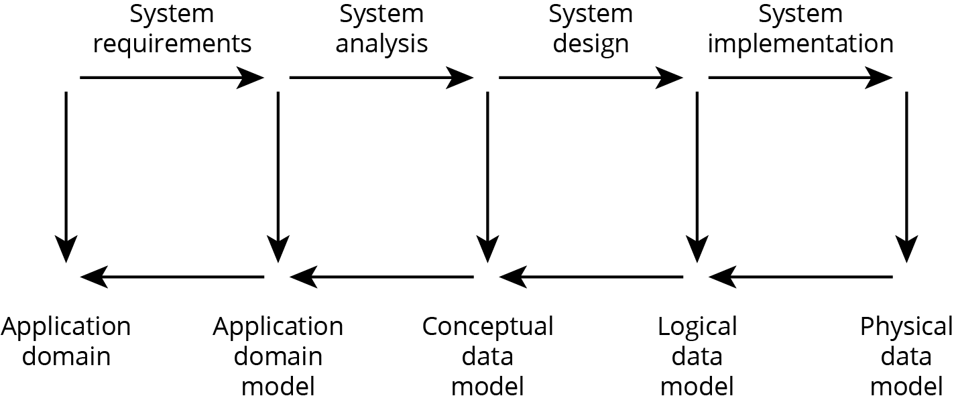
Models, information, and data
Information = data + context

Slide 18
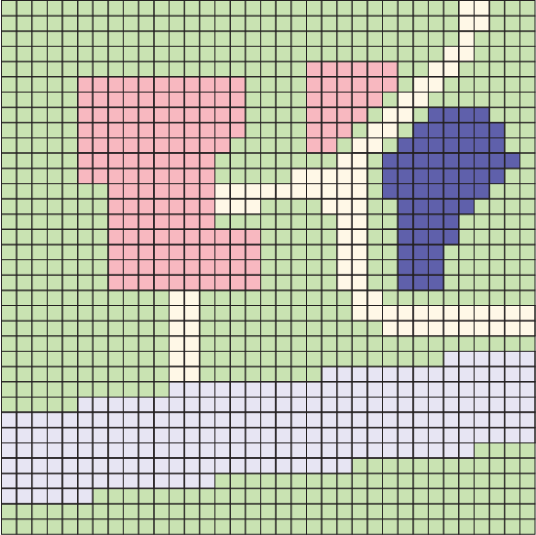
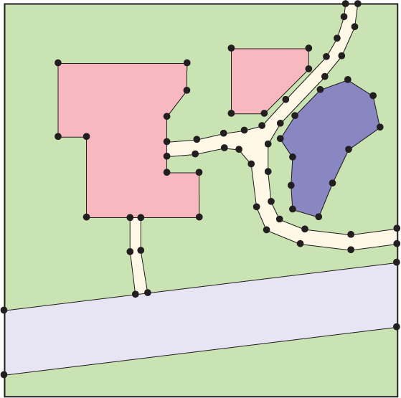
Raster and vector data
Raster data is structured as an array or grid of cells, referred to as pixels
Vector data is structured as points and line segments defined by end-points (vectors)

Slide 19
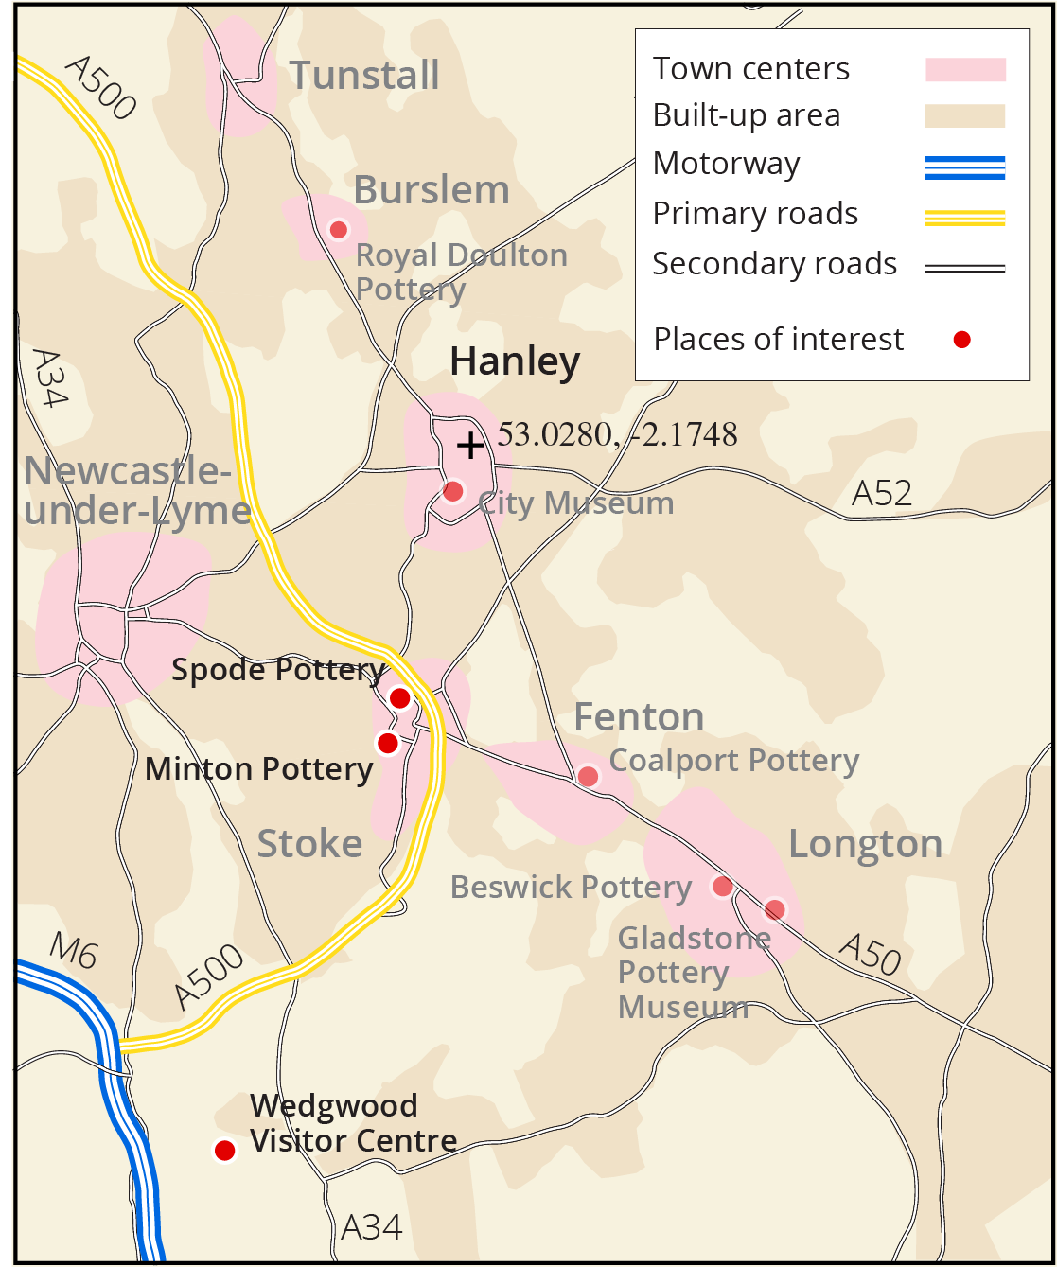
Spatial data retrieval
Retrieve the town that contains the lat-long coordinate location 53.0280, -2.1747 (a point query, answer “Hanley”).
Retrieve names and addresses of all potteries that lie outside built-up areas (a region query, answer “Wedgwood Pottery Centre”).
Retrieve the closest pottery to Minton Pottery (a nearest neighbor query, answer “Spode Pottery”).

Slide 20
Section 1.4
Computing technologies

Slide 21
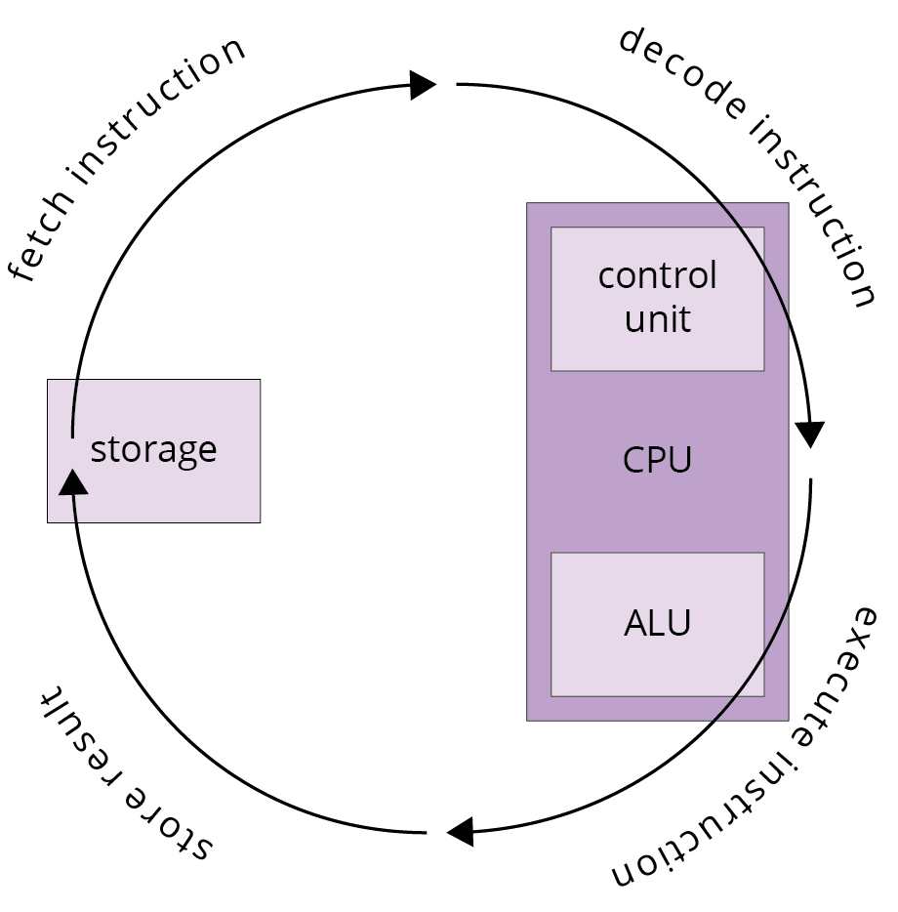
Processing and control
Processing of data in the computer hardware is handled by the central processing unit (CPU):
The control unit is responsible for the controlling, managing, and allocating resources.
The ALU (arithmetic/logic unit) is responsible for the actual processing functions.
The instruction cycle involves four steps:
retrieve an instruction from storage
decode the stored instruction to determine what operation must be performed
execute the operation
store the result

Slide 22
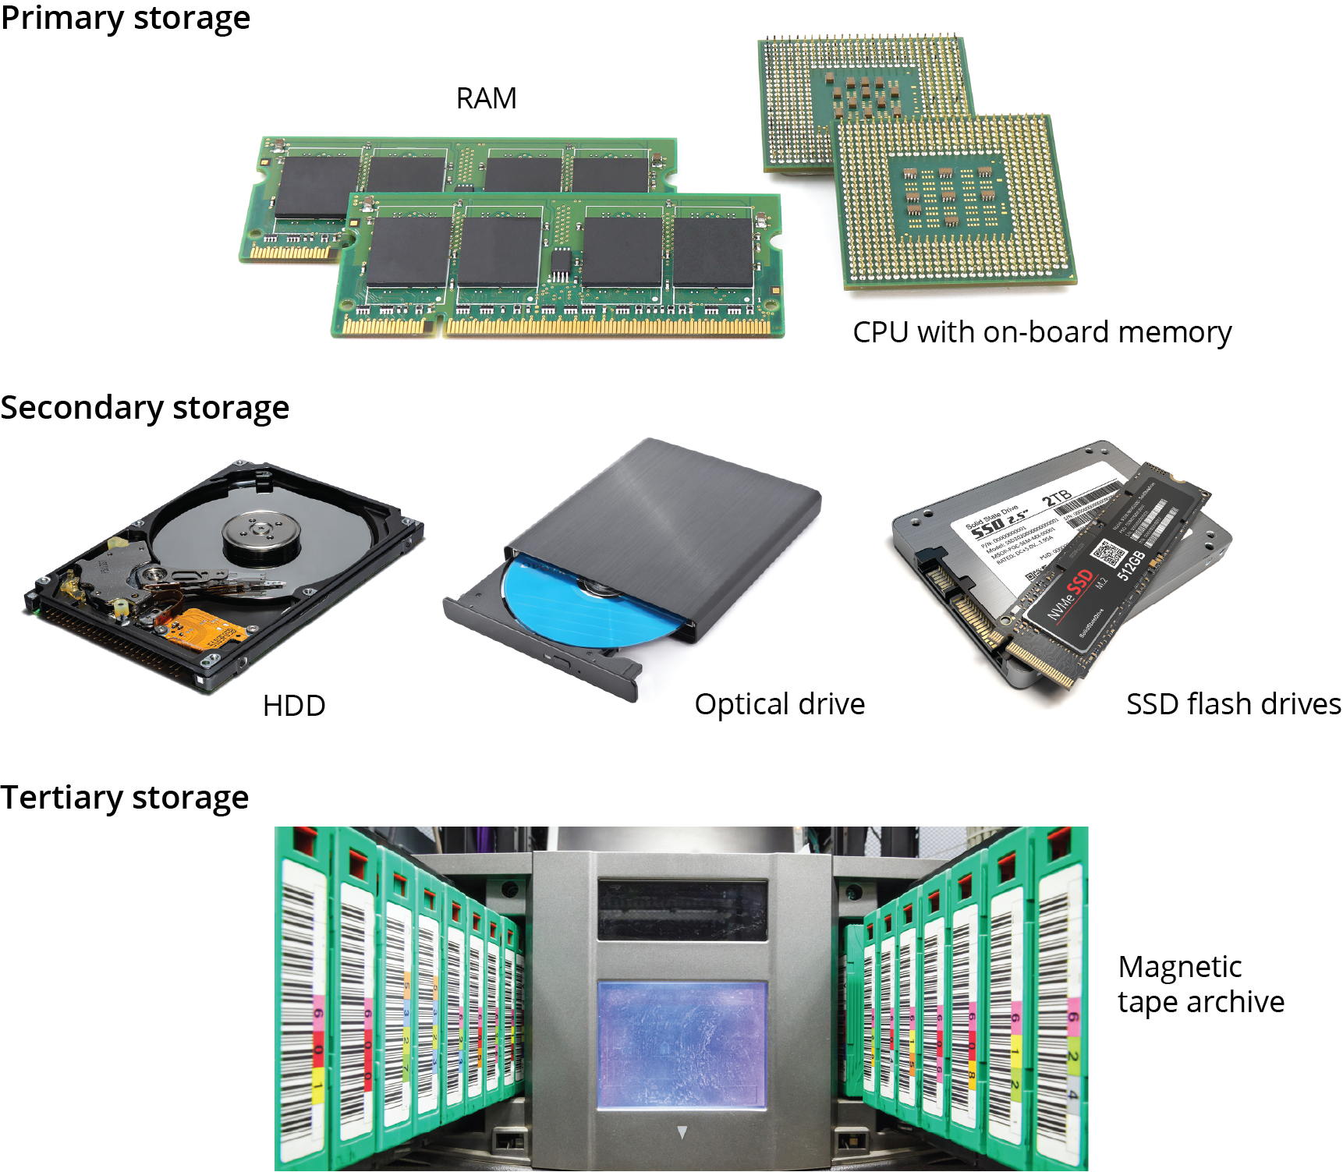
Storage
Primary storage that can be directly manipulated by the CPU: relatively expensive and generally volatile (stored data is lost when the power to the storage device is turned off).
Secondary storage that can be accessed only indirectly by the CPU: relatively cheaper than primary storage and normally non-volatile
Tertiary storage used to archive huge volumes of data that will be accessed only infrequently: the cheapest of all storage and always non-volatile.

Slide 23
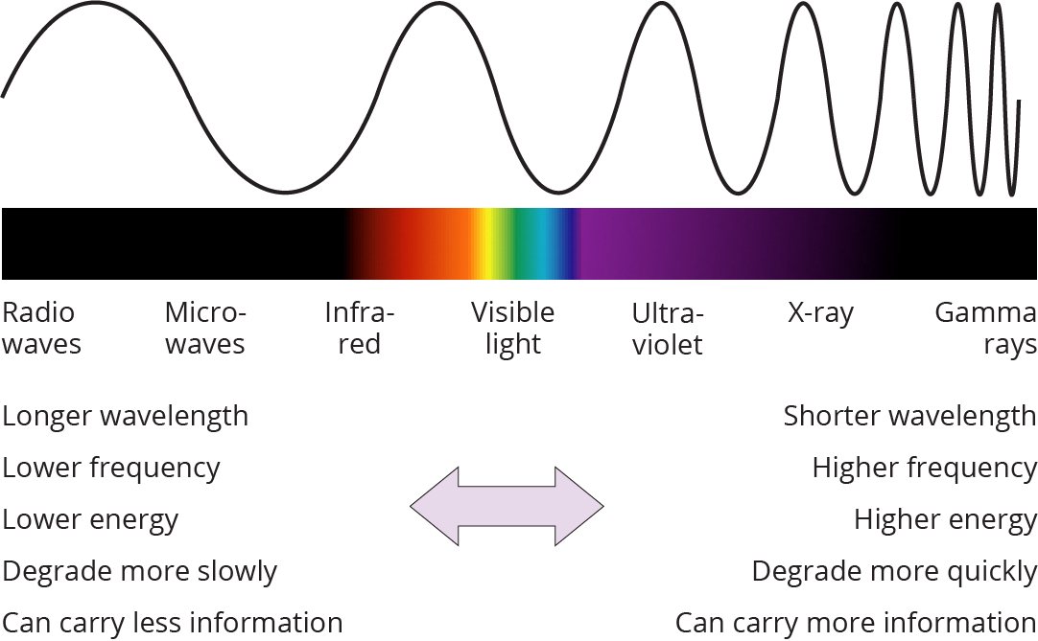
Digital communication
All communication networks use electromagnetic (EM) radiation as a carrier wave to propagate signals
The frequency of the carrier wave is the number of cycles a wave completes per unit time.
Frequency is inversely proportional to the carrier wave's wavelength: the length of each cycle.
Shorter wavelengths can carry more data than radiation with a longer wavelength.
However, shorter wavelength EM signals degrade more quickly than longer wavelengths
The range of wavelengths or frequencies available for data transmission is called the bandwidth

Slide 24
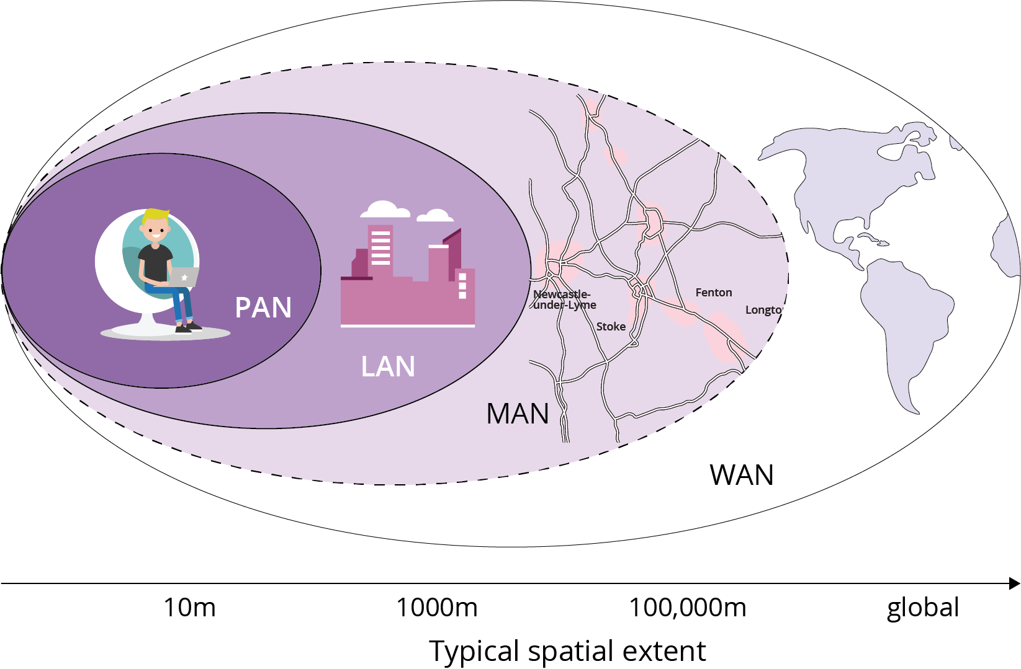
Communication networks
WAN (wide area network): operates over large-scale geographical regions, such as states and countries
LAN (local area network): connects groups of computers over medium- to small-scale geographical regions
PAN (personal area network): operates over very small geographic or sub geographic areas, typically only a few meters in size.

Slide 25
Section 1.5
What makes spatial special?

Slide 26
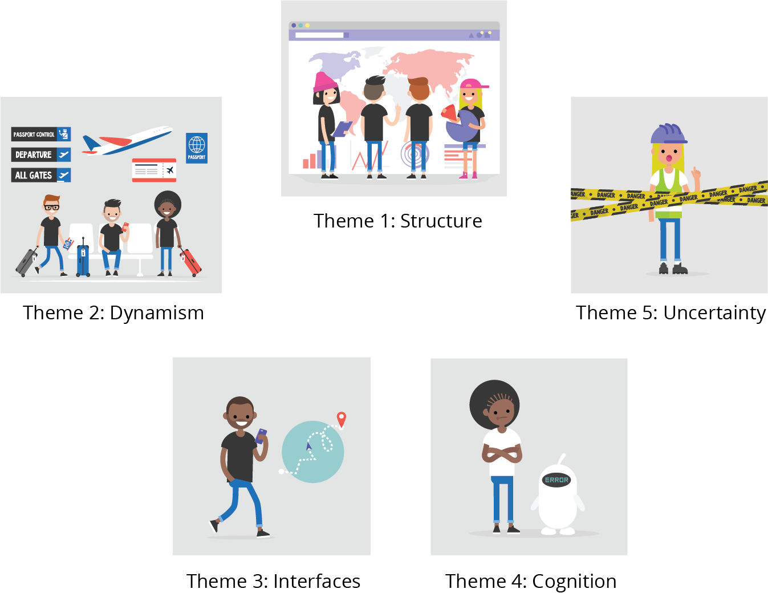
Theme 1: Structure
The structure of spatial information is different to other types of data and requires special handling.

Slide 27
Theme 2: Dynamism
Our geographical world is ever-changing.
Static “snapshots” are adequate for some purposes.
Dynamism acknowledges the need for more sophisticated, integrated spatiotemporal concepts and techniques in many cases.

Slide 28
Theme 3: Interfaces
Spatial data and GIS technology pervade almost every aspect of our lives today, from the biggest decisions of governments about how to respond to a global pandemic, to the smallest decisions about where to have lunch.
The connection between data and decisions is provided by an increasingly wide variety of interfaces.
To help people make the best possible decisions with the available data, those interfaces require careful and deliberate design.

Slide 29
Theme 4: Cognition
Humans have evolved specialized cognitive capabilities for understanding and processing information about space.
Effective collaboration between humans and GIS involves acknowledging their complementary strengths and weaknesses.

Slide 30
Theme 5: Uncertainty
Uncertainty is endemic in spatial data about that world.
We can never rely on spatial data with complete certainty.
Working with uncertainty required techniques for managing and learning from uncertainty, just as much as reducing or expunging uncertainty

Slide 31
Acknowledgments
Book website: http://gisacp.duckham.org All images: GIS: A Computing Perspective 3e, unless otherwise stated
Artwork: Lou Bloomer

